Slide 1



Security Testing
Presenter
Mohammad Anees Alam
Notes:
1

Slide 2







Topics for today !
Intro: Static code analysis
SAST & DAST overview
Common tools used for SAST & DAST
Penetration Testing
Ethical hacking & its limitations
Securing the CI/CD pipeline
Hands-on Activities
Notes:
2

Slide 3
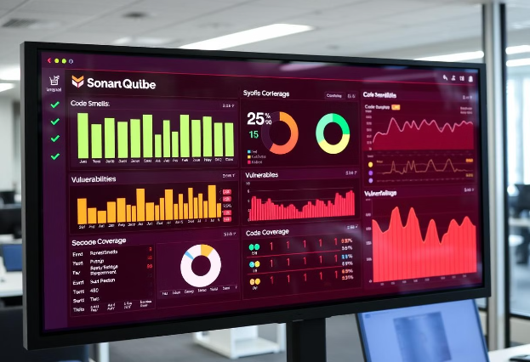
Static Code Analysis
Definition:
Static Code Analysis analyzes source code without executing it.
It identifies bugs, security vulnerabilities, and code smells early in the development cycle.
SAST - Static Application Security Testing
Static → Code is analyzed without execution.
Application → Focuses on software source code or binaries.
Security Testing → Aimed at identifying vulnerabilities, weaknesses, or security issues.
Notes:
3

Slide 4
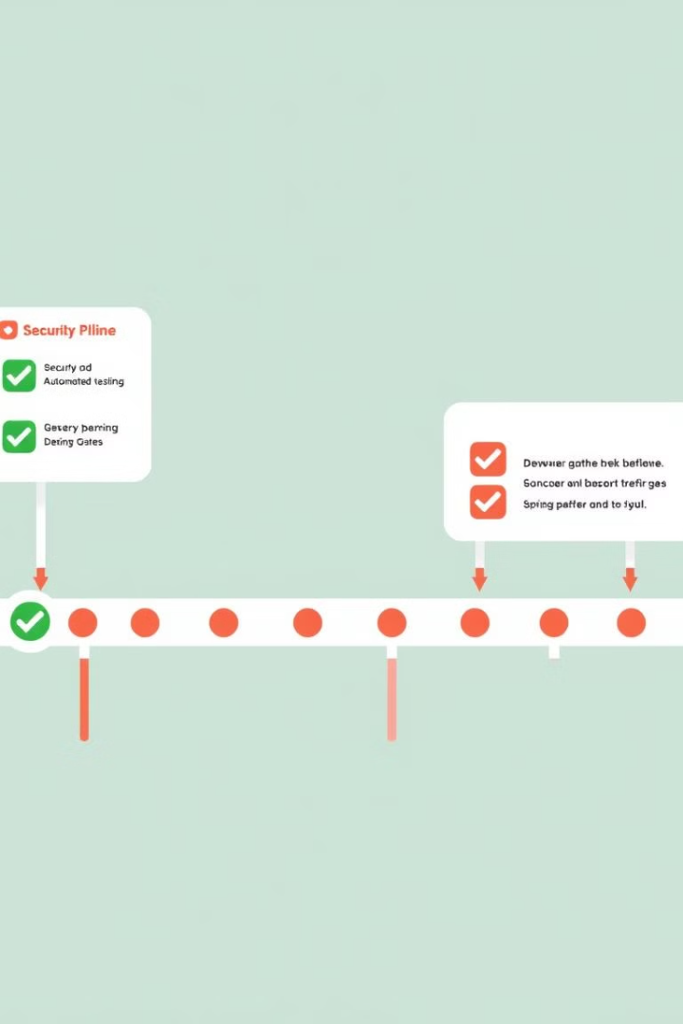
Why SAST is Important in DevOps
Early Detection: Catches security issues before deployment, following the "Shift Left" principle.
Automation: Integrates into CI/CD to scan every pull request.
Saves Cost: Fixing bugs in production is much more expensive.
Compliance: Helps meet standards like OWASP Top 10.
Common tools used:
  SonarQube
  Fortify
Notes:
4

Slide 5

Tool: SonarQube
SonarQube is an open-source tool for analyzing code quality and security.
It supports many languages like Python, Java, and JavaScript.
The web dashboard displays bugs, code smells, and security hotspots.
Setup Guide and hands-on: Here
Notes:
5

Slide 6

Do we have any existing software or a tool that already does this?
IF YES, then how is it different from SonarQube ??
Notes:
6

Slide 7
A sample from VS Code : Spot the error !
def send_email(recipient, subject, body)
password = "SuperSecret123"
print("Sending email to", recipient)
Notes:
7

Slide 8
VS Code vs SAST:
Let's understand the use-case of using SAST when we have an existing tool to highlight our code mistakes.
def send_email(recipient, subject, body)
password = "SuperSecret123"
print("Sending email to", recipient)
def send_email(recipient, subject, body):
password = "SuperSecret123"
print("Sending email to", recipient)
VS Code
SonarQube
  VS Code shows a red squiggly: SyntaxError: expected ':'
  This updated code will run successfully in the VS Code without any errors, but SonarQube will catch an error here…. Why ?
  The code won’t run due to the missing colon on the def line.
  This is a syntax-level error, caught by the editor.
Notes:
8

Slide 9
Summary
Tool
What it detects
Code Outcome
VS code
Syntax errors (like missing :)
Code won’t run
SonarQube
Hardcoded secrets, insecure patterns
Code runs fine, but is unsafe
Notes:
9

Slide 10
Tool: Fortify
Enterprise-grade security scanning for compliance and threat mitigation.
What is Fortify?
Fortify, developed by OpenText (formerly Micro Focus), is a Static Application Security Testing (SAST) tool widely used by enterprises to:
  Analyze source code for potential security vulnerabilities.
  Ensure compliance with standards such as OWASP Top 10, CWE, PCI-DSS, and NIST.
  Detect security risks early within the software development lifecycle and CI/CD pipelines.
Typical Use Cases
  Government or financial applications needing strict compliance.
  Enterprises who need in-depth static analysis with customizable rules.
  CI/CD pipelines that must reject insecure builds automatically.
Notes:
10

Slide 11
Quick overview of Fortify
Aspect
Description
Type
Static Application Security Testing (SAST)
Input
Source code (Java, Python, JS, C#, etc.)
Output
Detailed security vulnerability reports with line-by-line code context
Goal
Catch and fix security flaws before deployment
Deployment
Can be run on-premise or integrated into CI/CD pipelines
Notes:
11

Slide 12
Dynamic Application Security Testing (DAST)
Dynamic Application Security Testing (DAST) is a technique used to identify vulnerabilities in running web applications.
  Unlike SAST, which analyzes source code, DAST operates from the outside—treating the application as a "black box" and focusing on its behavior.
  It simulates an external attacker interacting with the app through a browser, without access to the underlying code.
DAST typically identifies issues such as:
  SQL Injection (e.g., ?id=1 OR 1=1)
  Cross-Site Scripting (XSS)
  Broken authentication mechanisms
  Misconfigured security headers (e.g., missing Content Security Policy)
Common Tools used are : OWASP ZAP & Burp Suite.
Notes:
12

Slide 13

Tool: OWASP ZAP
ZAP - Zed Attack Proxy
  Open-source security scanner from OWASP.
  Simulates attacks to find vulnerabilities.
  Offers both GUI and CLI interfaces.
Phase
Description
Spider
Crawls the site and builds a sitemap
Passive scan
Observes responses (e.g., insecure cookies, headers)
Active scan
Tries to exploit issues (XSS, SQLi, etc.)
Notes:
13

Slide 14
Hands-on Activity
Scan a Local Web App using ZAP to understand the functionality.
1
Install ZAP
#mac: MIGHT NOT BE SUPPORTED
brew install --cask owasp-zap ,
To run: open -a "OWASP ZAP"
#Linux:
sudo apt update, sudo apt install snapd, sudo snap install zaproxy [This installs ZAP via Snap.]
To run: zaproxy
2
Scan a Local Web App
You can use testphp.vulnweb.com/ for a local app.
Step 1: Launch ZAP
open ZAP.app file or use run command to open ZAP.
Step 2: Set Up the Scan
  In "Quick Start" tab:
    Enter: testphp.vulnweb.com/ and click on Attack
ZAP will spider the site (crawl all pages) then run passive + active scans.
Notes:
14

Slide 15
Tool: Burp Suite
Burp Suite (developed by PortSwigger) is a powerful tool for web vulnerability scanning and penetration testing. It enables security professionals and DevOps engineers to:
  Intercept and manipulate HTTP/HTTPS traffic
  Automatically scan for security vulnerabilities
  Identify issues such as XSS, SQL Injection, and CSRF
  Replay, edit, and fuzz HTTP requests to evaluate application responses
How Burp Suite Works:
  The browser sends an HTTP/HTTPS request.
  Burp Suite intercepts the request before it reaches the server.
  You review or modify the request as needed.
  Burp forwards the request to the target server.
  The server responds, and the response passes back through Burp.
  The modified or original response is then displayed in your browser.
Notes:
15

Slide 16

Penetration Testing
Penetration Testing (or Pen Testing) is a simulated cyberattack against your system to uncover security weaknesses before malicious hackers can find and exploit them.
  Goal: Identify vulnerabilities in software, networks, or systems.
  Approach: “Ethical hackers” (with permission) attempt to exploit systems the same way a real attacker would.
Pentesting is an important component of a security testing strategy.
In the DevOps lifecycle, it's typically done after deployment but can be automated in CI/CD pipelines using tools that simulate attacks.
Notes:
16

Slide 17
Ethical Hacking
Ethical hacking is the authorized, legal process of testing systems by attempting to bypass security measures to uncover potential vulnerabilities.
  Who performs it? Trained and certified professionals with explicit permission.
  Why is it done? To improve security by identifying weaknesses from the perspective of a potential attacker.
How is it different from penetration testing ?
  Scope & Coverage:
    Penetration Testing targets specific systems or applications.
    Ethical Hacking may include broader methods like social engineering or physical security testing.
  Tools & Methods:
    Both use similar tools, but ethical hacking may also involve non-technical techniques (e.g., phishing).
  Purpose & Authorization:
    Pen Testing assesses system-specific security.
    Ethical Hacking focuses on improving overall cybersecurity, always with explicit legal permission.
Notes:
17

Slide 18
Tools for Penetration: Nmap & Metasploit Framework
NMap (Network Mapper)
Metasploit Framework
Purpose:
Detects open ports, active services, and possible entry points in a network.
Purpose:
Executes real-world exploits to test the impact of known vulnerabilities.
Use Case:
Used to map devices, identify operating systems, and find vulnerable ports within a network.
Use Case:
After identifying a weakness (like outdated software), Metasploit simulates how an attacker could exploit it.
Notes:
18

Slide 19
Hands-on Activity
Simulate a basic penetration test on our own machine to understand how attackers might discover and analyze open services.
1
Install Nmap
brew install nmap / sudo apt install nmap
2
Start a Local Web Server
In a new terminal:
python3 -m http.server 8000
This starts a basic HTTP server on port 8000.
3
Scan Your Localhost With Nmap
Run this in a separate terminal:
nmap -sV -p 8000 localhost
  -sV = Service version detection
  -p 8000 = Scan port 8000 (where our local server runs)
4
Output Sample
  Port: 8000/tcp
  State: open
  Service: http
  Version: Python SimpleHTTPServer
Notes:
19

Slide 20
Legal & Ethical Considerations
Always Have Permission
Stay Within Scope
Avoid Data Breach
Report Responsibly
Comply with Laws
Notes:
20

Slide 21
Securing the CI/CD Pipeline
Why CI/CD Needs Security
CI/CD pipelines should prevent insecure code from reaching production. Integrating security tools early in the pipeline (“shift left”) helps catch vulnerabilities during development.
Common Tools to Integrate:
  SonarQube – Static code quality and security analysis (SAST)
  ZAP CLI – Dynamic application testing after deployment (DAST)
  Secret Scanners – Detect API keys and secrets in commits
  Bandit (Python) – Security-focused linting for Python code
Notes:
21

Slide 22

We have completed all the modules of testing.
Next stop …. Continuous Deployment !!
Notes:
22

